Slide 1

Red Teaming & Offensive Security
By Harsh Tandel @ Hack-X MIT WPU Club

Slide 2

$whoami
CVE 2022-334
Security Consultant
P1 Warrior Bugcrowd
Intigriti Globally Top 1000
Certified Blockchain Security Examiner
Certified in Cyber Warfare and Terrorism
Speaker & Writer

Slide 3

Red Teaming 101
A red team in the military is a group that pretends to be an enemy and attempts to breach an organization's defenses, either physically or digitally. The red team then reports back on their findings so the organization can improve their defenses.
Attack is the secret of defence; defence is the planning of an attack
-The Art of War, Sun Tzu
The term "red team" comes from military exercises, where the red team takes on the role of the enemy and the blue team defends their position. The same concept is used in cybersecurity, where the red team simulates cyber attacks to test an organization's digital defenses.
Here we try to simulate attacks done by attackers like APT(Advanced Persistent Threat) ,Malicious hacker groups.To prevent and secure against actual attacks using TTP( Tactics, Techniques and Procedures).

Slide 4
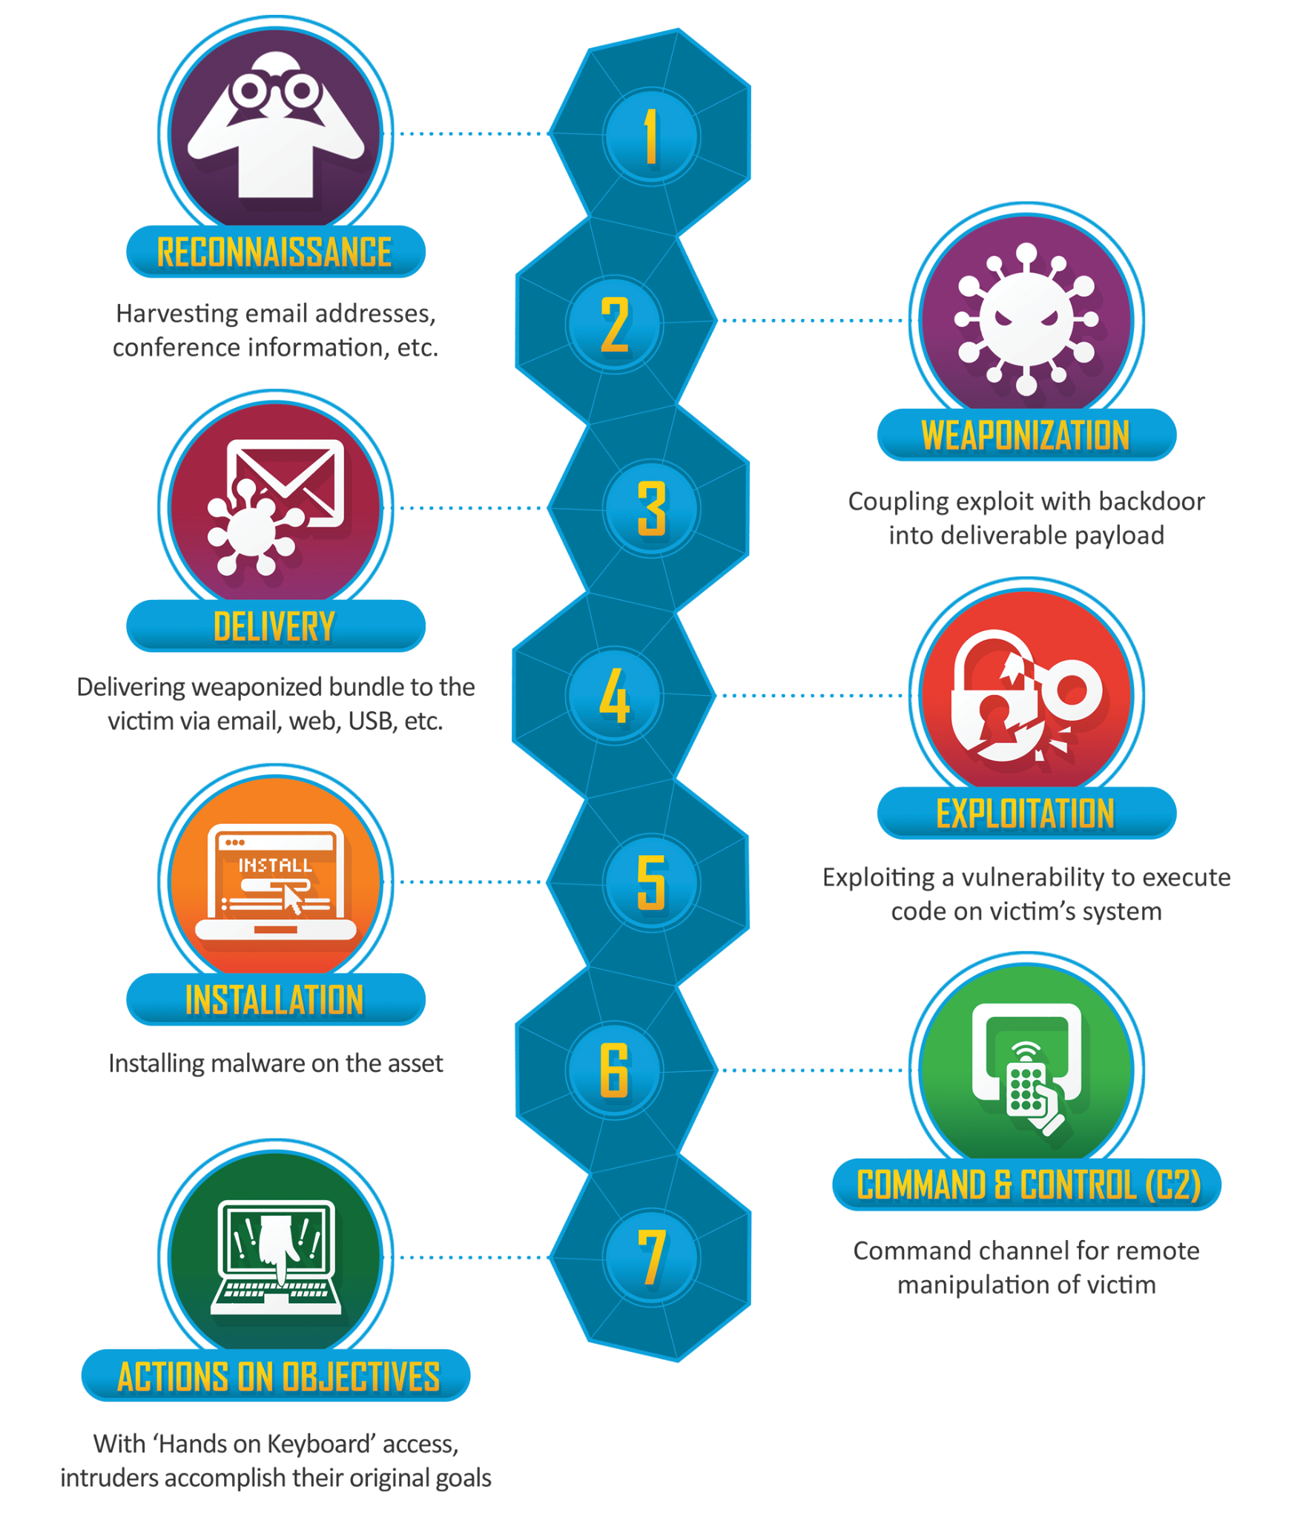
Red Teaming Approach
We will follow the “Lockheed Martin cyber kill chain” Model
As it is most recognised and used model in industry.
Step 1: Recon
Step 2: Weaponization
Step 3: Delivery
Step 4: Exploitation
Step 5: Installation
Step 6: Command and Control
Step 7: Actions on Objectives

Slide 5

Practical approach
Reconnaissance: Tools that gather information about the target environment, such as IP addresses, open ports, and network configurations.Also use OSINT to increase attack surface and hidden grounds
Exploitation: Tools that exploit vulnerabilities to gain unauthorized access to systems.Also use social engineering to exploit the organisation.
Privilege Escalation: Tools that elevate the attacker’s permissions to gain higher-level access within the environment.
Lateral Movement: Tools that facilitate movement across the network, allowing the attacker to explore and compromise additional systems.
Exfiltration: Tools that enable the extraction of sensitive data from the target environment.
Post-Exploitation: Tools that maintain persistence, clean tracks, or further exploit compromised systems.

Slide 6

Tools
Reconnaissance: Nmap, Masscan, Recon-ng, Amass, Sublist3r
Exploitation: Metasploit, Impacket, Responder, SQLmap
Privilege Escalation: WinPEAS, PowerUp, BloodHound, Kerbrute
Lateral Movement: PSExec, WMIC, Rubeus, CrackMapExec
Persistence: Empire, Cobalt Strike, Mimikatz
Data Exfiltration: DNSCat, Powershell Empire, HTTPS Tunnels

Slide 7
AWS Red Teaming
1.Reconnaissance:
Enumerate AWS assets (EC2, S3, IAM, RDS).
Identify exposed services, misconfigurations, and leaked credentials.
Use OSINT tools like CloudMapper and AWSRecon.
Initial Access:
Exploit misconfigured IAM policies, S3 buckets, or leaked AWS keys.
Utilize SSRF or web application vulnerabilities to gain access.
Tools: Pacu, nimbostratus, ScoutSuite.
Privilege Escalation:
Exploit weak IAM roles, policies, or credentials.
Abuse IAM trust policies or escalate privileges via Lambda functions.
Tools: AWSPX, WeirdAAL.
Lateral Movement:
Pivot across AWS services (EC2 instances, RDS, Lambda).
Access and compromise additional AWS accounts using AssumeRole.
Tools: Pacu, AWS CLI.
Persistence:
Create backdoors (new IAM users, access keys, EC2 instances).
Use CloudFormation templates or Lambda functions for stealthy persistence.
Tools: BackdoorFactory, AWS Shell.
Exfiltration and Cleanup:
Exfiltrate sensitive data (e.g., S3 buckets, RDS snapshots).
Cover tracks by deleting CloudTrail logs and modifying AWS CloudWatch configurations.
Tools: S3Copy, CloudGoat.

Slide 8
EDR Bypass Techniques
Living off the Land (LotL):
Leverage built-in tools and legitimate binaries (LOLBAS) like PowerShell, MSHTA, WMI, and CertUtil to perform malicious activities.
Example: Using PowerShell scripts for fileless malware execution.
Obfuscation:
Obfuscate payloads or scripts to avoid signature-based detection.
Techniques: Base64 encoding, string manipulation, and dynamic code execution.
Tools: Invoke-Obfuscation, Invoke-DOSfuscation.
In-Memory Execution:
Load and execute payloads directly in memory without touching disk, reducing the chances of being detected by EDR.
Techniques: Reflective DLL Injection, Process Hollowing, Shellcode Injection.
Tools: Cobalt Strike, Donut, SharpSploit.
Process Injection:
Inject malicious code into legitimate processes to mask the activity.
Techniques: DLL Injection, APC (Asynchronous Procedure Call) Injection, Remote Thread Injection.
Tools: Mimikatz, Cobalt Strike, Metasploit.
Fileless Malware:
Use techniques that don't rely on writing files to the disk, like malicious macros in documents or script-based attacks.
Example: Utilizing HTA (HTML Application) or JavaScript for initial payload delivery.
EDR Hooking Evasion:
Unhook or restore original system DLLs to remove EDR userland hooks that monitor API calls.
Tools: GhostPack's Seatbelt, SysWhispers, Hollow's Trick.
Signed Binary Abuse (BYOI - Bring Your Own Interpreter):
Abuse signed binaries to execute malicious code (e.g., rundll32.exe, msiexec.exe).
Example: Using InstallUtil.exe to run malicious scripts.
Disabling EDR:
Identify and exploit misconfigurations or vulnerabilities to disable or manipulate EDR services.
Techniques: Service Stop/Deletion, Tampering with EDR Registry Entries.

Slide 9

Automating Red Teaming
In the era of AI and ML automation is the important part we need to learn so here are some automation tools which can help in gathering attack surface and automating basic assessment.
Reconnaissance
Rengine
OSINT
SpiderFoot
Assessment
Caldera From Mitre
Atomic Red Team By Red Canary
RTA by Elastic/ Endgame Inc

Slide 10

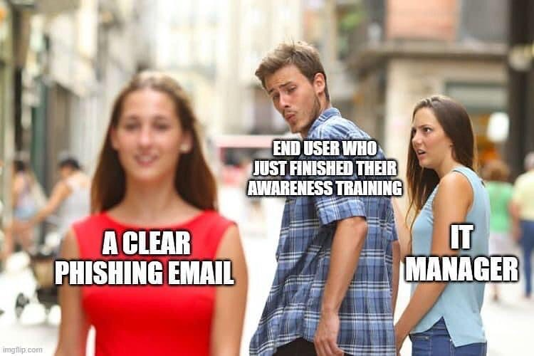
Offensive Security
Vulnerability Assessment :- Scan the infrastructure/Network/Cloud with known vulnerabilities and CVEs with automated scanner like Nessus and Qualys etc.
Penetration Testing :- Validate the vulnerabilities found in VA and Manually try to penetrate the application on network using tools like burp suite and postman etc.
Cloud Security Testing :- Cloud Security testing involves cloud pentesting,Configuration review and DevSecOps.
Social Engineering:- Here Con Artists Will Engaged With client Employees and extract Information from them.use Spear -Phishing ,Pharming, Vishing ,Tail getting and others.
“Wickets And Strongest Chain of Defence Is Humans Mind ”

Slide 11

That’s All for Now
Thank You All

